Slide 1
CALCULATOR USING GITHUB
TEAM-
1. PRASHANT BHUNAL- HIMACHAL PRADESH
2. RAHUL THAKUR- HIMACHAL PRADESH
3. NAMAN JAIN- DELHI

Slide 2
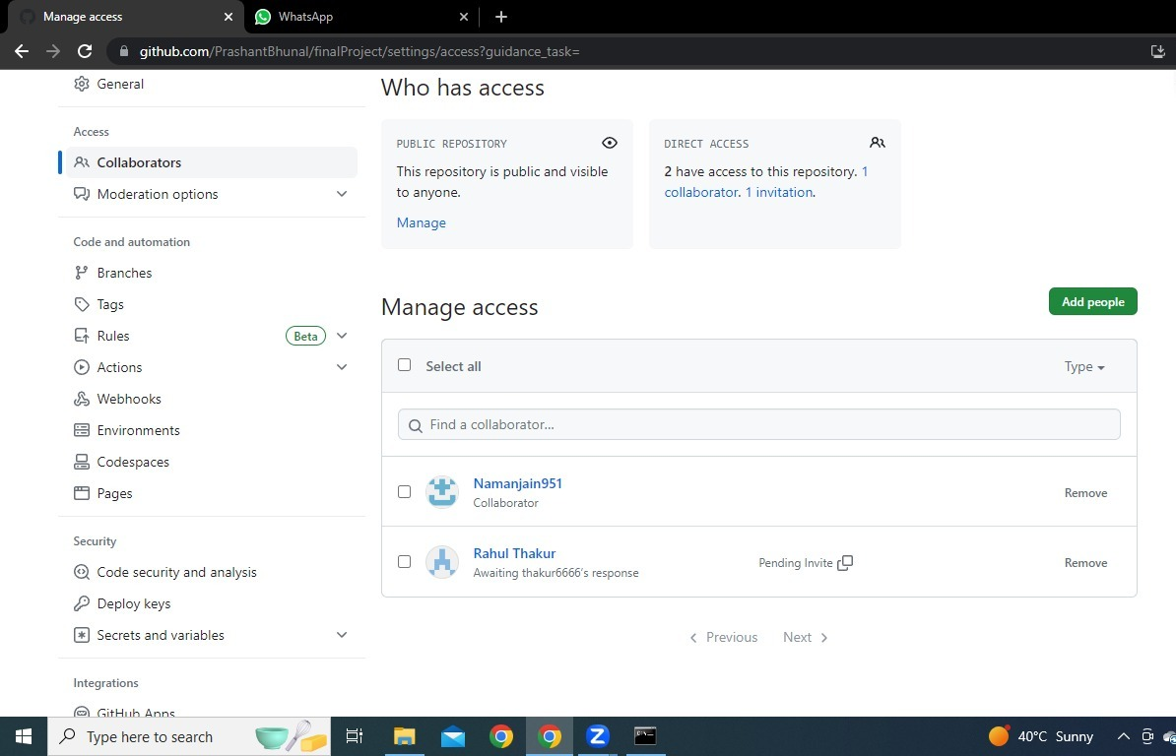
SHARING OF FILES
COLLABORATION FEATURES OF GIT HUB

Slide 3
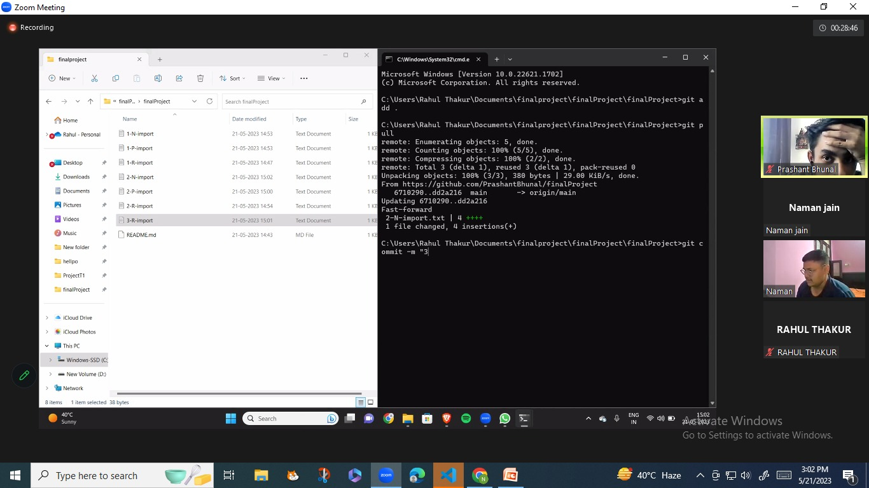
Exchanging Of Codes

Slide 4
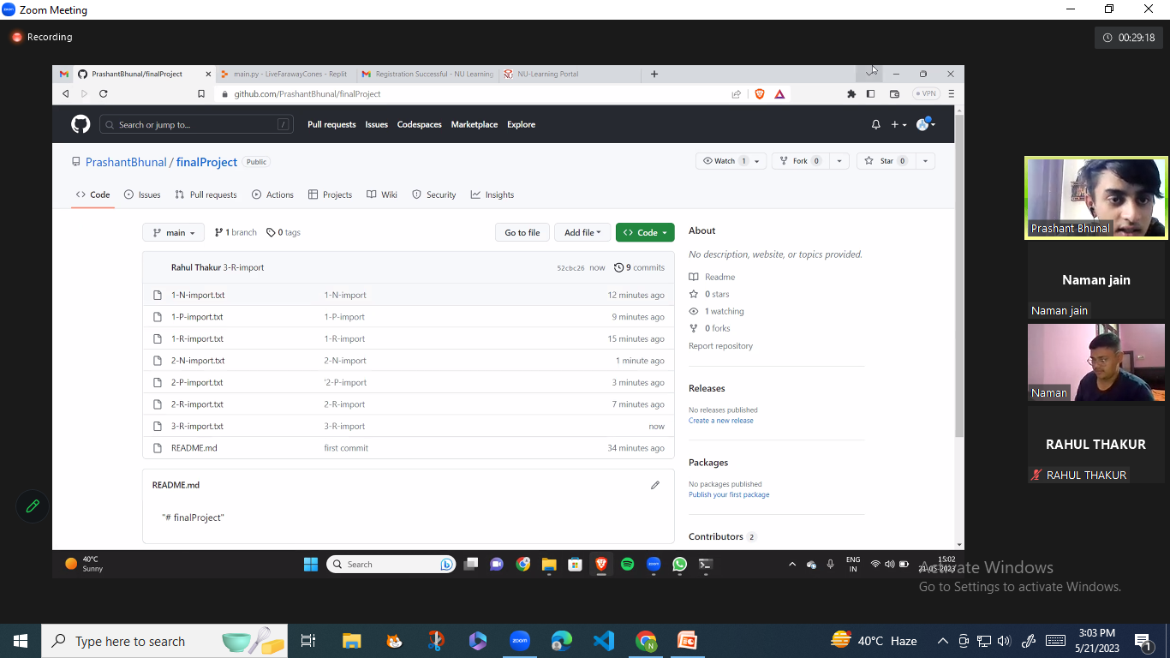

Slide 5
Using Of Commands
Git clone – For Cloning The Repository in other machines
Git add . – For adding a file in local repository
Git commit – For committing the added file
Git push – For uploading the file from local repository to master repository
Git pull – For Extracting the files to the machines.
Git status – For viewing the status of files in repository

Slide 6
Use Of Git Push And Git Pull
Git Push
Git Pull
For uploading the file from local repository to master repository.
For Extracting the files to the machines.

Slide 7
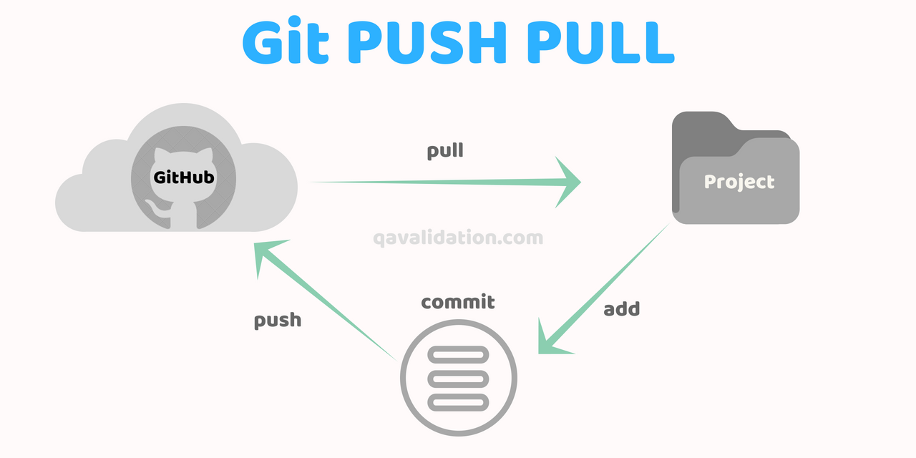

Slide 8
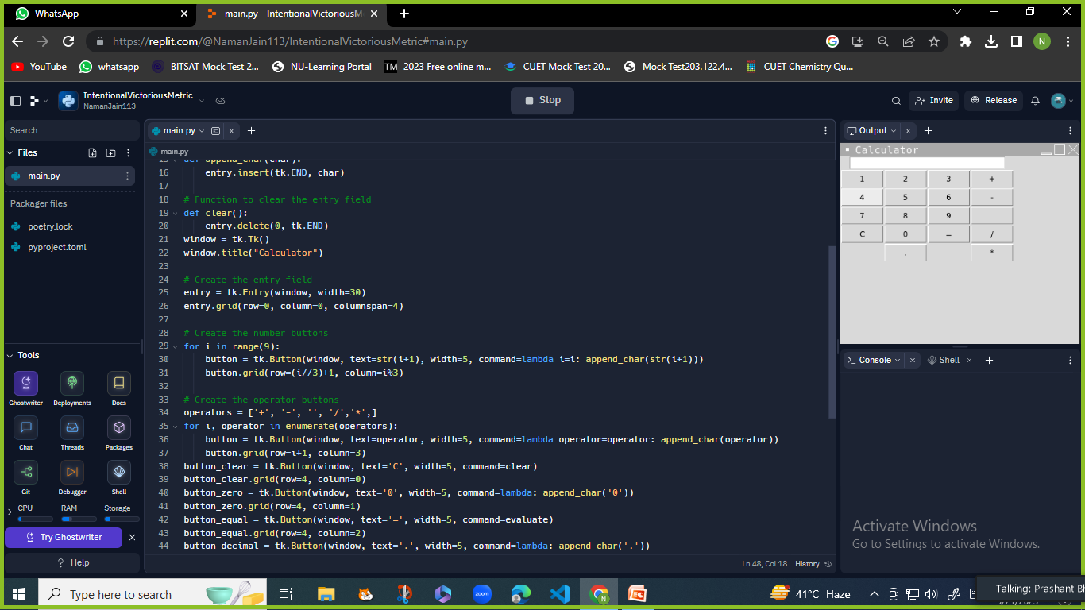
Python Codes For Calculator

Slide 9

Use Of Code Editor

Slide 10
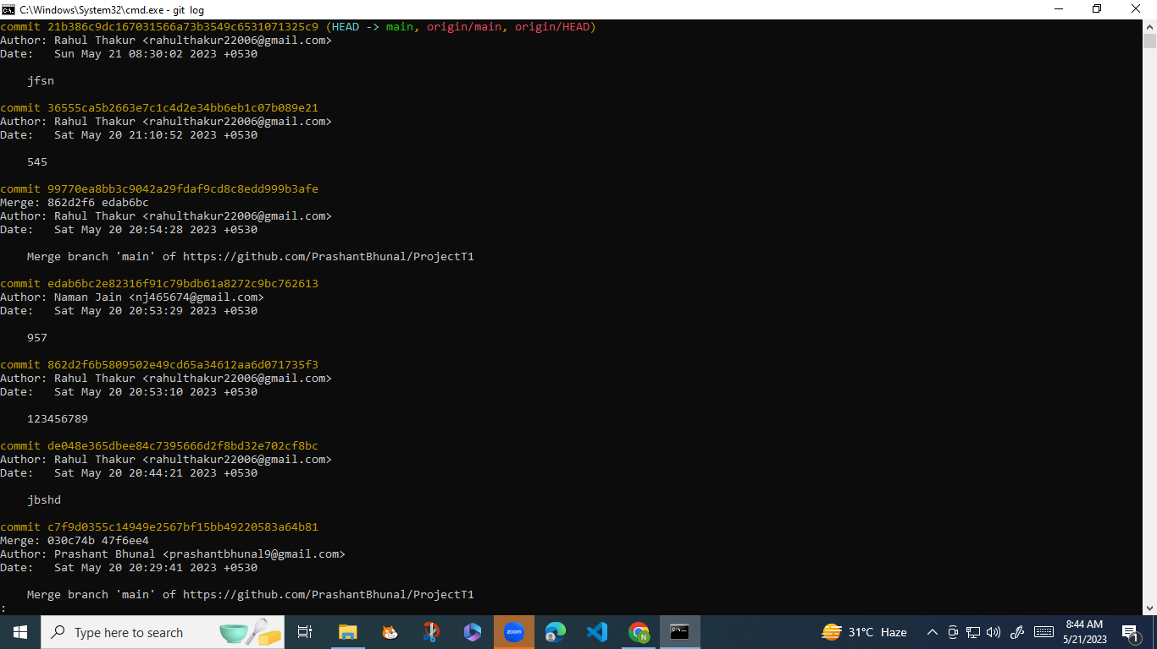
How To Use Checkout And Log Command

Slide 11
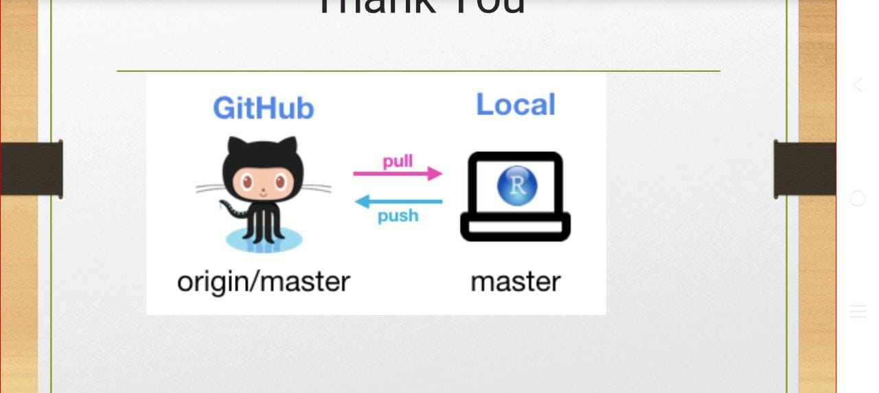
Thank You NIIT UNIVERSITY

